Slide 1
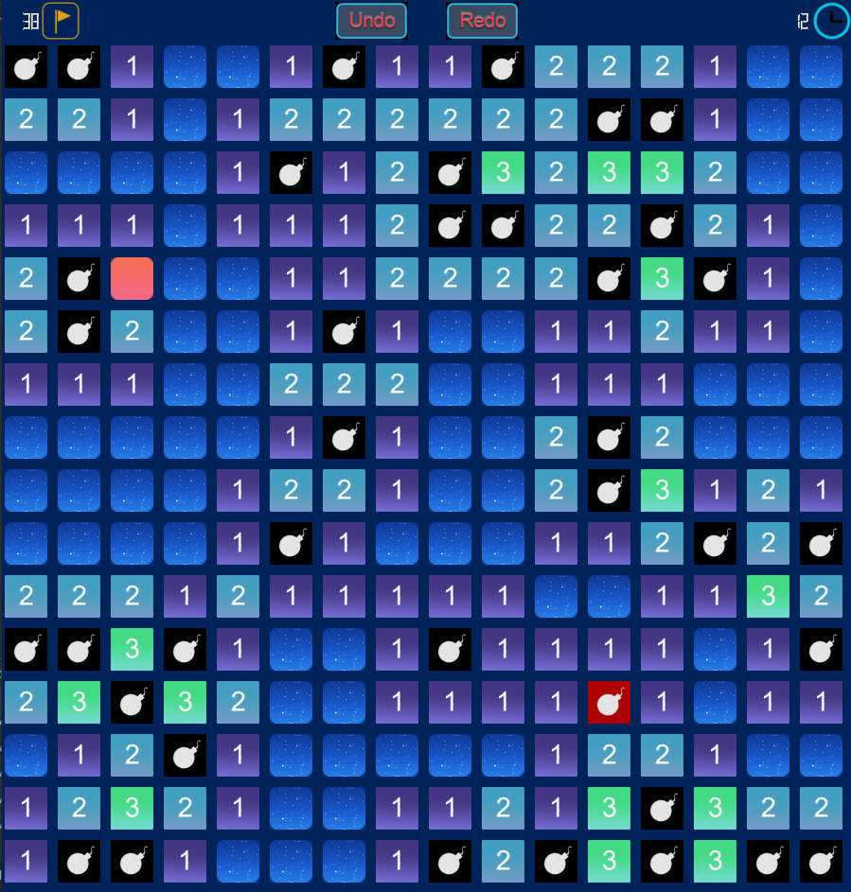

Duration: 15 mins
Python
PyQt5 + Numpy ?
Modern GUI
Minesweeper
Course Project
Team Members
Phạm Hoàng Minh (ITITIU19031)
Phạm Công Tuấn (ITITIU19060)
Trần Ngọc Tiến (ITITIU19217)
Course: Data Structure & Algorithms
Instructor: Mr. T. T. Tùng

Slide 2
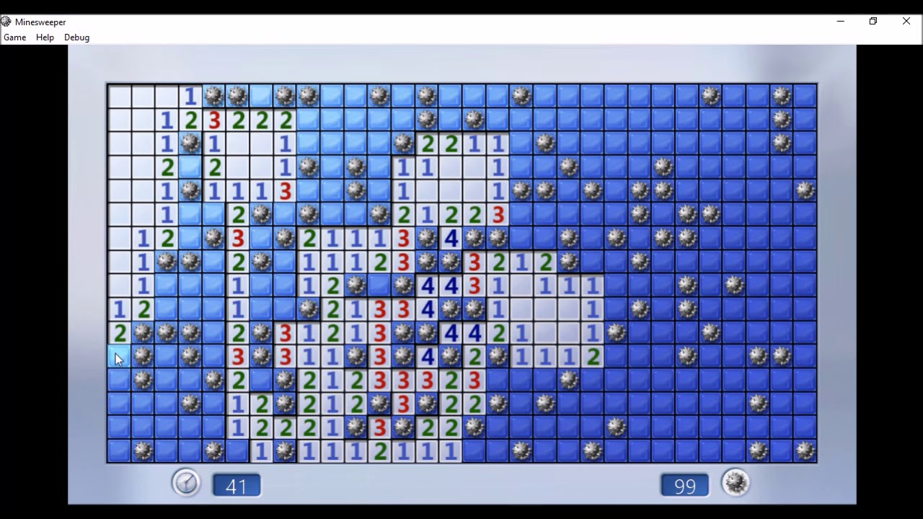
Introduction
Minesweeper is a single-player puzzle video game. The objective of the game is to clear a rectangular board containing hidden "mines" or bombs without detonating any of them, with help from clues about the number of neighboring mines in each field.

Slide 3
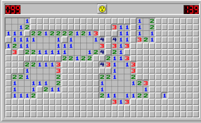
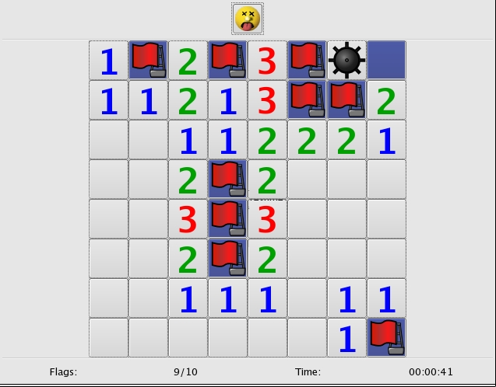


MODERN GUI
WHAT DO WE HAVE ?
WINDOWS 7
DEVELOPMENT

Slide 4

WHAT DO WE HAVE ?
FINAL PRODUCT

Slide 5

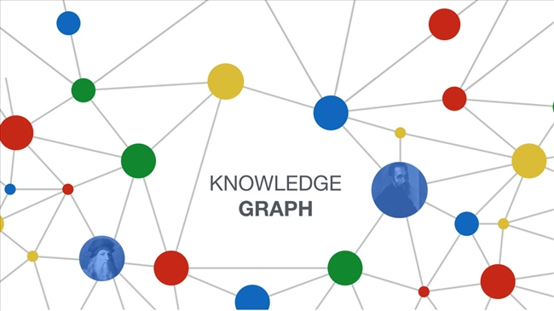
OPTIMAL GRAPH
WHAT DO WE HAVE ?
How to Trigger when clicked on empty block?
Youtube + (Normal) Posts (Blogs)
(Normal) Graph Design
Click XYZ, Open ZYZ
Click A, Open A + B + …

Slide 6

OPTIMAL GRAPH
WHAT DO WE HAVE ?
Memory Efficiency
Easy to Code & Debug
BORING !!!
Memory Inefficiency
Hard to Code & Debug
HOW ???
FUNNY !!!

Slide 7

OPTIMAL GRAPH
WHAT DO WE HAVE ?
HOW ???

Slide 8
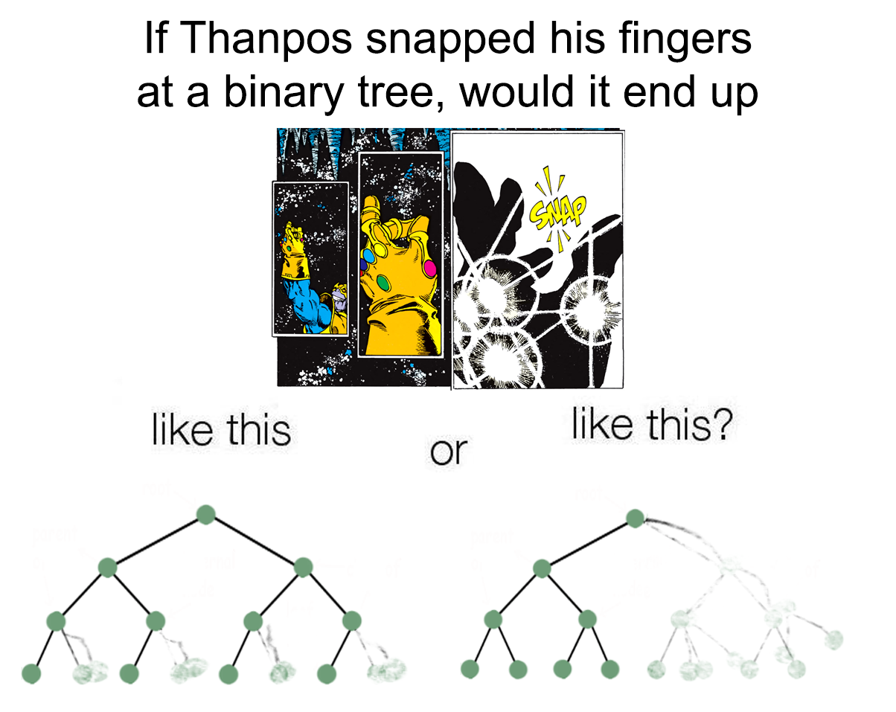
OPTIMAL GRAPH
WHAT DO WE HAVE ?
Depth First Flow in Minesweeper
Inherited from Depth First Search
Apply Mathematical Function
Expand to Boundary from Center to any positions
If Thanos snapped his fingers at a binary tree, would it end up
RESULTS
Time Complexity: O(V^2 || V + E) -> O(N)
Space Complexity: No Extra Adjacency Matrix | Dictionary

Slide 9
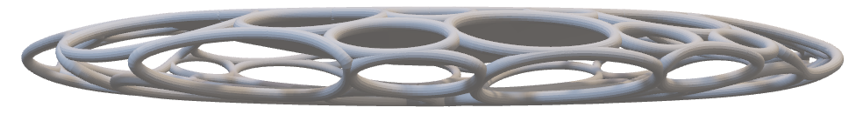
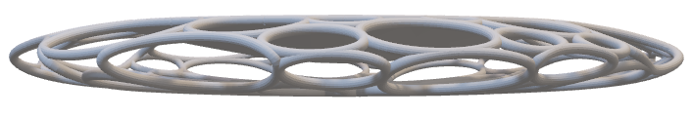
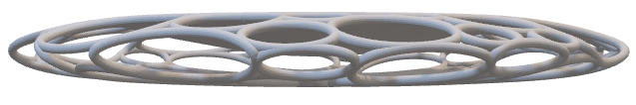

REDO-UNDO
WHAT DO WE HAVE ?
STACK
Save current state into another stack.
Get value from the clicked stack
Set that value as representation
Remove the “another” stack if overflowed
Current state
RESULTS
Balancing memory
Record the current state for replay
Oldest state

Slide 10

PERFORMANCE
WHAT DO WE HAVE ?
Database Recording
Finished Playing game
Acquire Performance
Insert First into the Database
Display your first 20 latest performance recorded associated with gaming level

Slide 11
SINGLETON
DESIGN PATTERN
Singleton Design Pattern
This pattern was implemented through out the project (all classes) to ensure that each object was run by its own
Dependency state was transferred by message. There are no hidden attribute stored on other object.

Slide 12
OBSERVER
DESIGN PATTERN
Observer Design Pattern
The observer pattern is a software design pattern in which an object, named the subject, maintains a list of its dependents, called observers, and notifies them automatically of any state changes, usually by calling one of their methods.
It is mainly used for implementing distributed event handling systems, in "event driven" software. In those systems, the subject is usually named a "stream of events" or "stream source of events", while the observers are called "sinks of events. This pattern then perfectly suits any process where data arrives from some input that is not available to the CPU at startup, but instead arrives "at random" (HTTP requests, GPIO data, user input from keyboard/mouse/..., distributed databases and blockchains, ...).

Slide 13
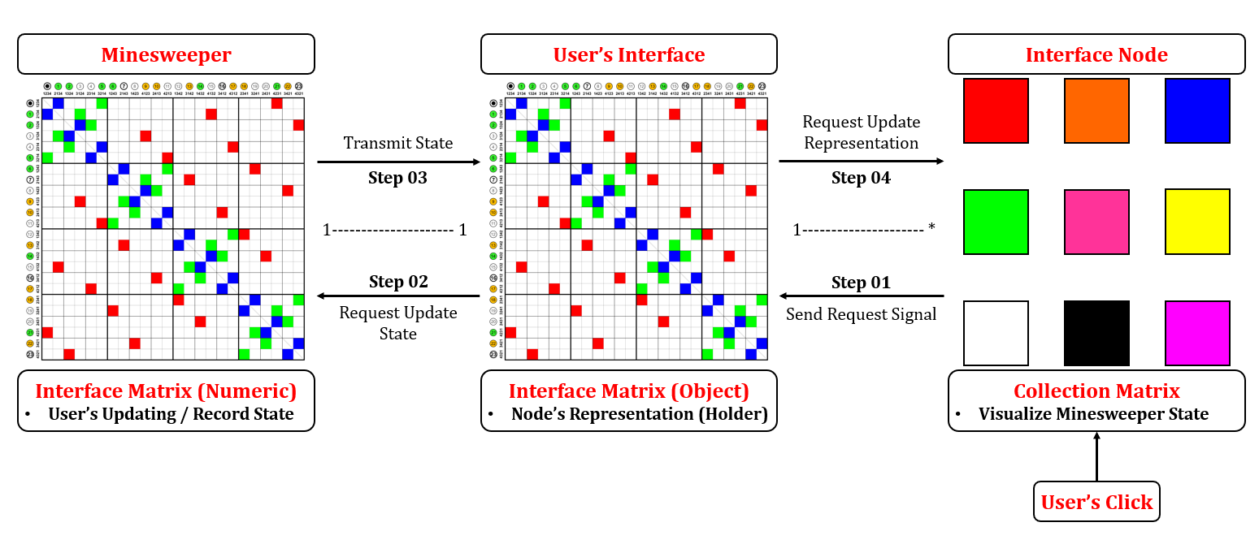
OBSERVER
DESIGN PATTERN

Slide 14
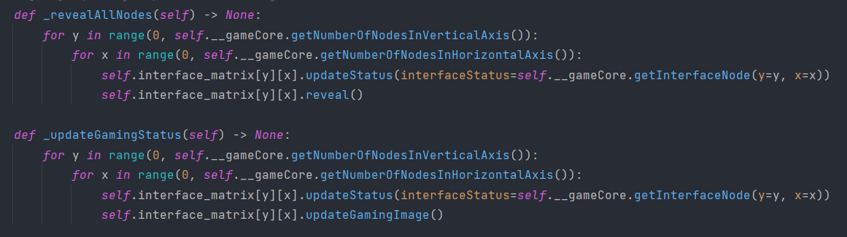
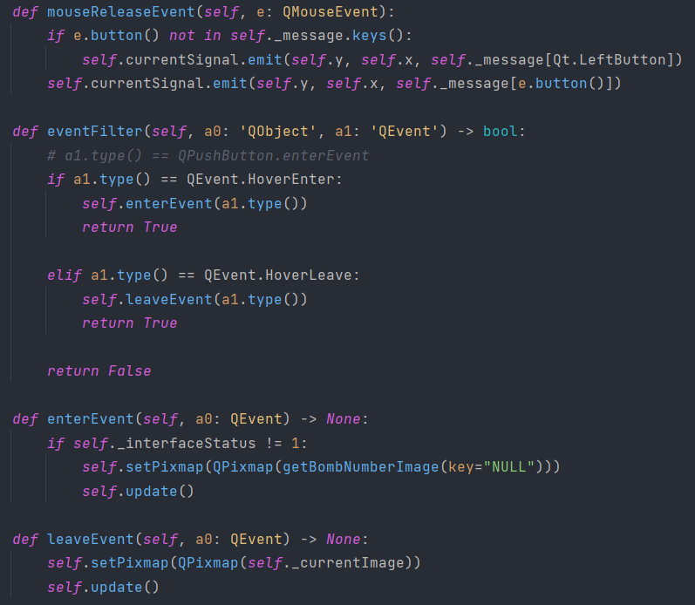
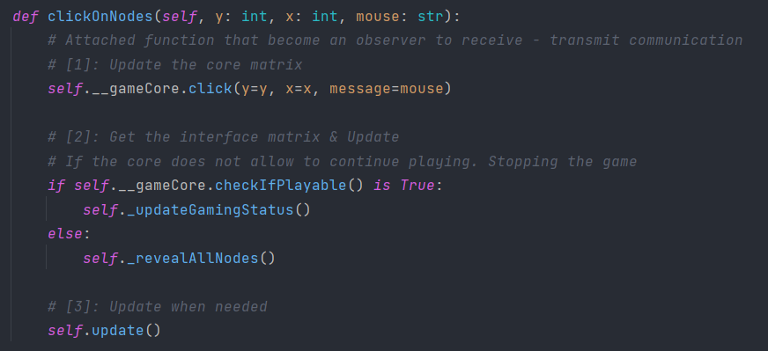
OBSERVER
DESIGN PATTERN

Slide 15
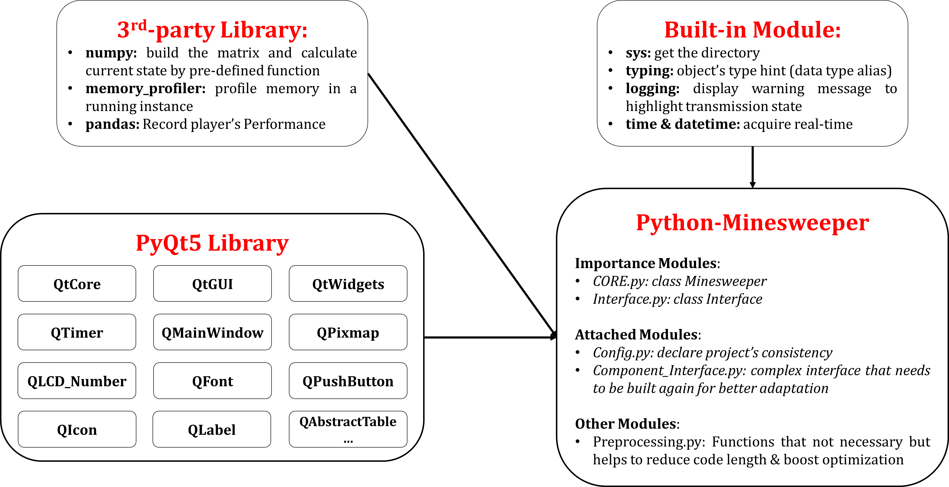
Dependency
UML Design

Slide 16
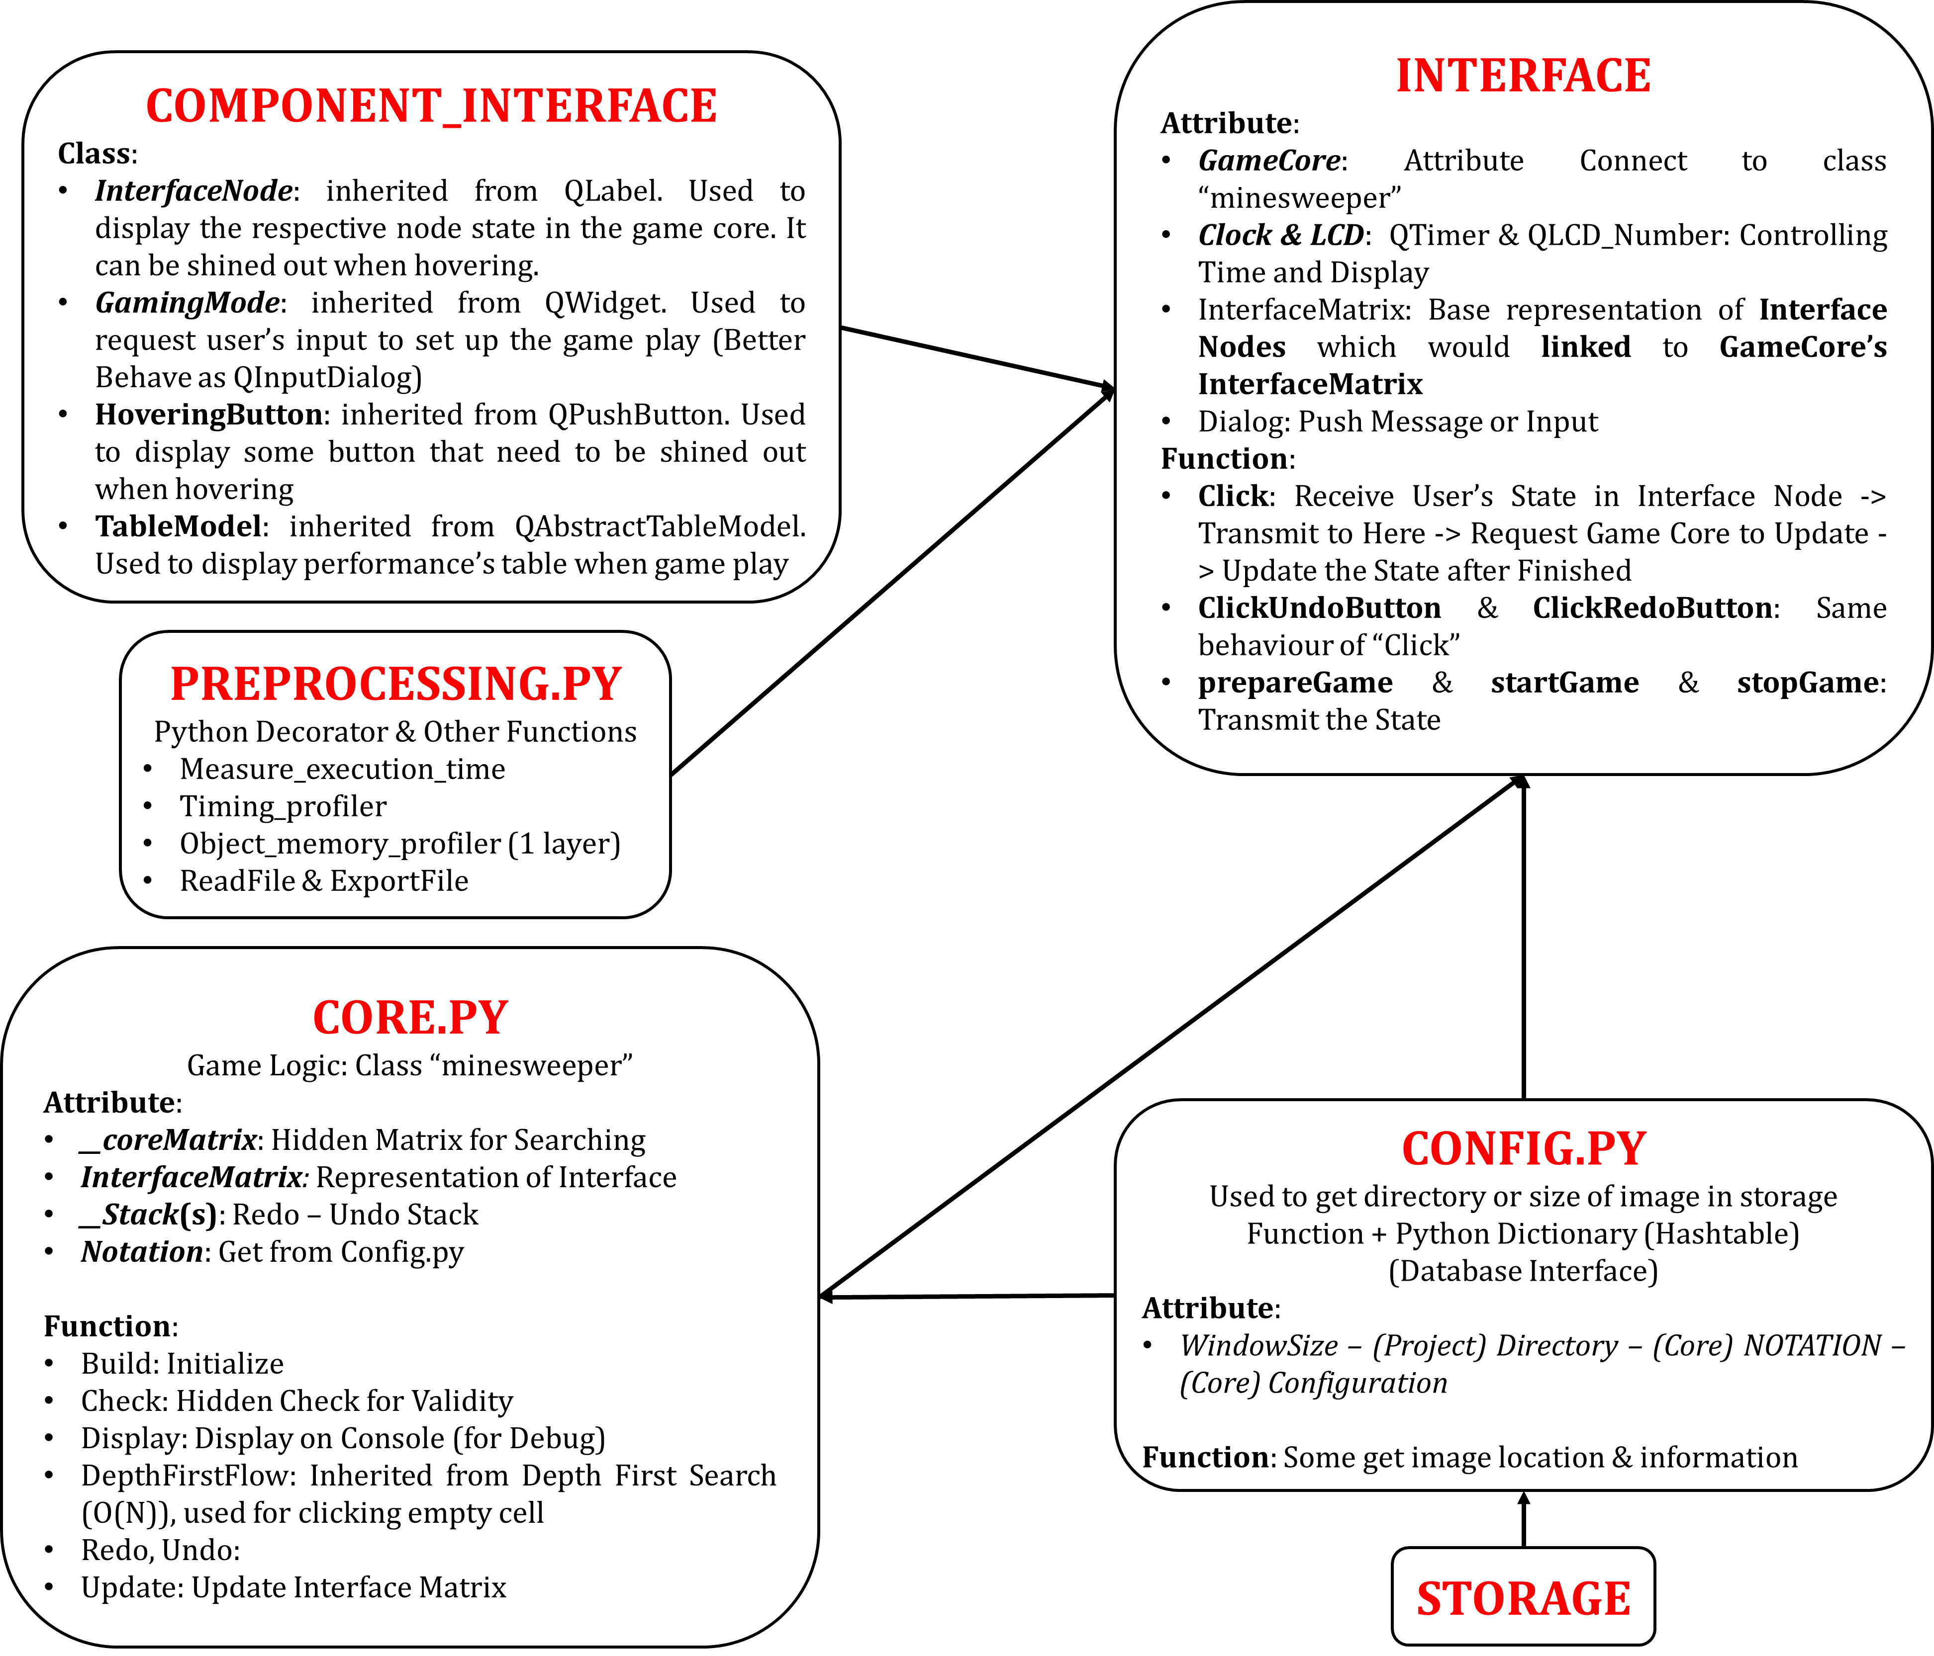
You can separate module config.py into core_config and interface_config to get better design pattern

Slide 17
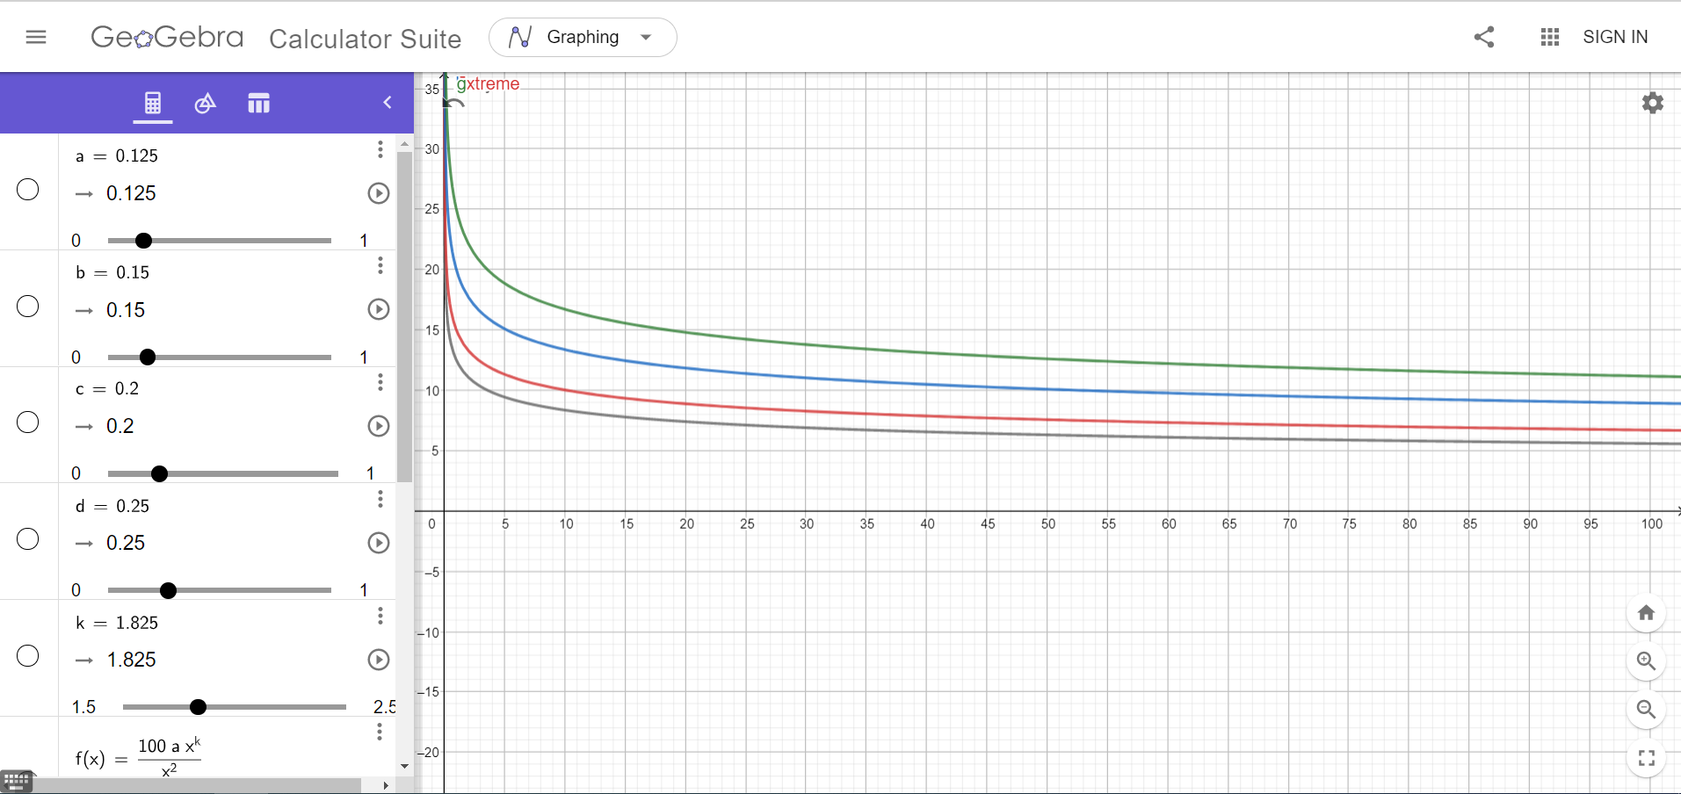

Slide 18

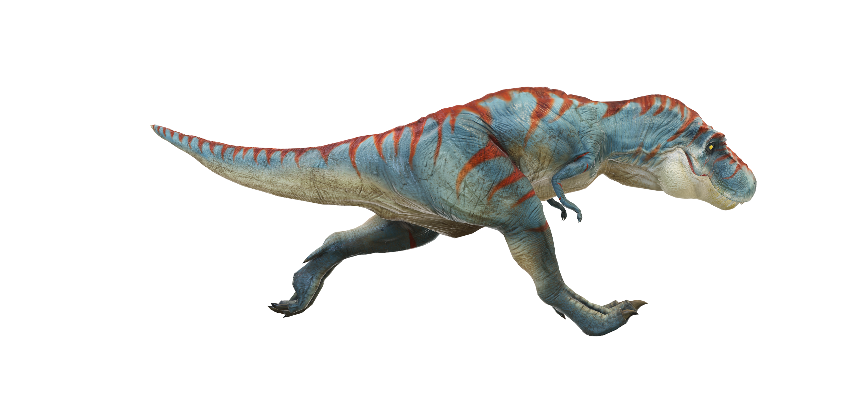
DEMO

Slide 19

Thanks for Listening!

